Slide 1
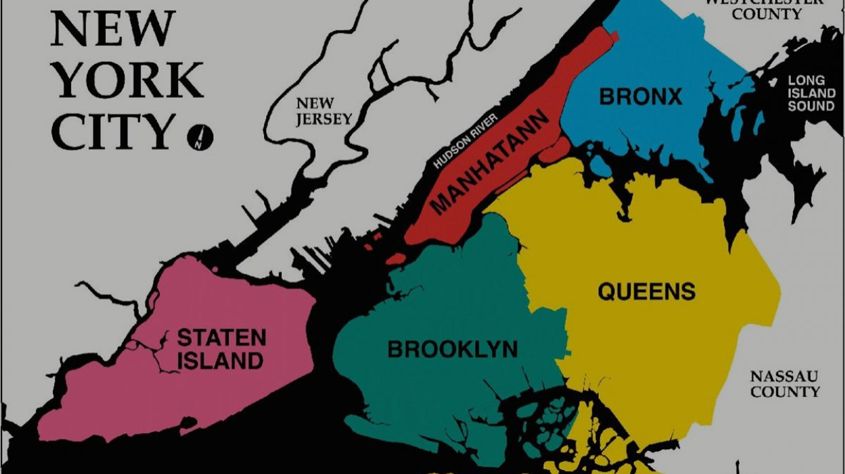
NYC Rentals Analysis
Maria Zamudio
Rohini Muttur
Jana Chatterjee

Slide 2

Project Description
Using datasets from AirBnB, StreetEasy, and NYC Open Data, we created a multi-tiered analysis to determine if there are similarities between short term and long-term rentals in New York City.
Additionally, understand if the rental housing market is having an impact in societal factors.
The following hypotheses were considered:
The neighborhoods with the cheapest rent will have more rental listings.
The neighborhoods with the maximum complaints impact pricing in short and long term rentals.
The average median price decreases as the distance from the city center increases.
Neighborhoods offering the most amount of listings are more expensive.

Slide 3



Resources and Cleansing
merge
merge
merge
NYC OpenData is free public data published by New York City agencies and other partners.
CSV
2018 311 Complaints by Borough
Cleansing description:
Remove NaN
Standardized and renamed
Convert non-numeric columns to numbers.
Re-writing and Merging 5 files into 1
StreetEasy has the largest set of real estate listings for New York City.
CSV
Median Asking Price: 2010-2018
Inventory: 2010-2018
Cleansing description:
Remove NaN
Standardized and renamed
Convert non-numeric columns to numbers.
Mapping of latitude and longitude
Airbnb is an online marketplace that connects people who want to rent out their homes with people who are looking for accommodations
CSV
Listings for 2018
Neighborhoods geojson
Cleansing description:
Remove NULL values
Standardized and filter
Normalise columns

Slide 4
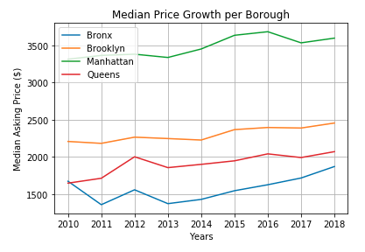
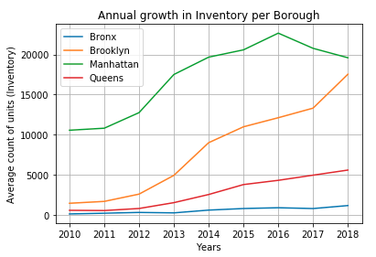
StreetEasy Data: 2010 - 2018
INSIGHT: Starting in 2016, median price rental went down for Queens and Brooklyn which might explain why the available inventory of Manhattan rentals is trending down, while Brooklyn and Queens are trending up.

Slide 5
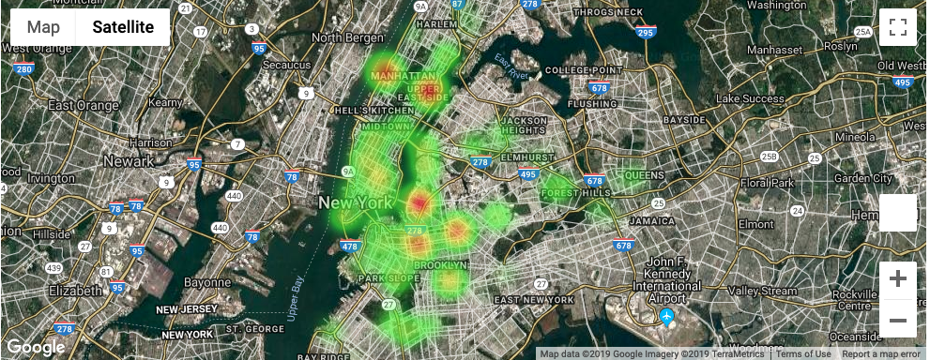
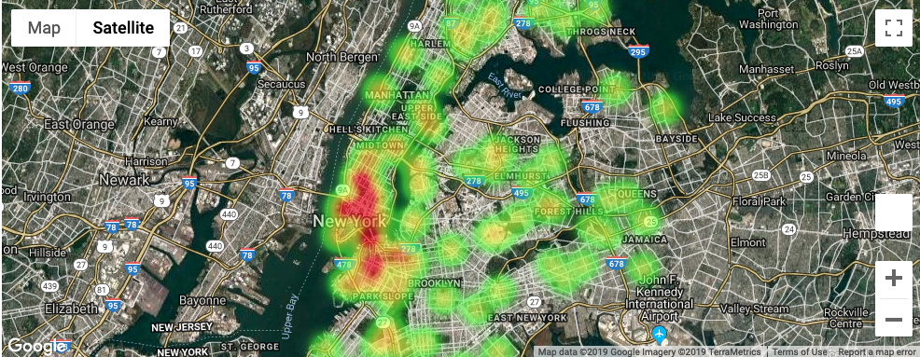
StreetEasy Data: Pricing and Listing Distribution 2018
Count of Units
INSIGHT: There is no intersection of data between the number of units and median asking price.
Median Asking Price

Slide 6
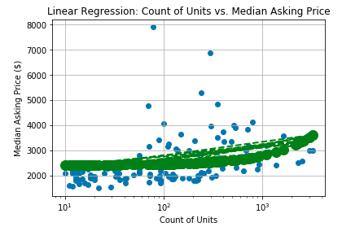
StreetEasy Data: Linear Regression| Pricing and Listing Distribution 2018
INSIGHT: The count of available units per neighborhood is not related with the Asking Median Price. The graph shows highest prices within neighborhoods having the average count of available units.

Slide 7
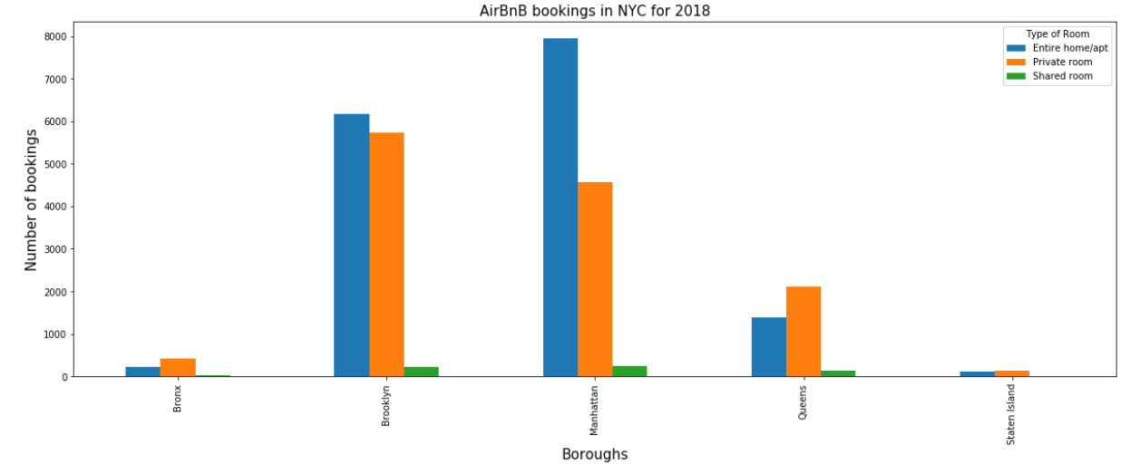
AirBnB listings in NYC 2018
INSIGHT: 1) Manhattan has the highest number of listings closely followed by Brooklyn.
2) Entire Home/Apt are the popular choices except in Queens where Private rooms are more popular.

Slide 8
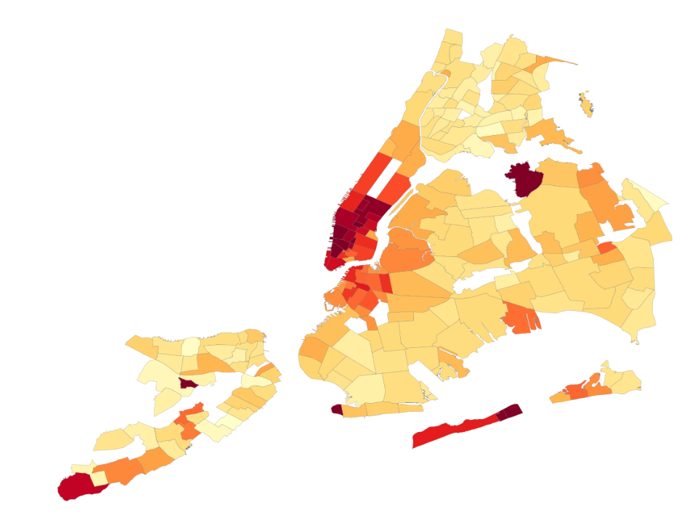
AirBnB Data: Price Wise Distributions
INSIGHT: Manhattan has the priciest listings followed by Brooklyn.

Slide 9
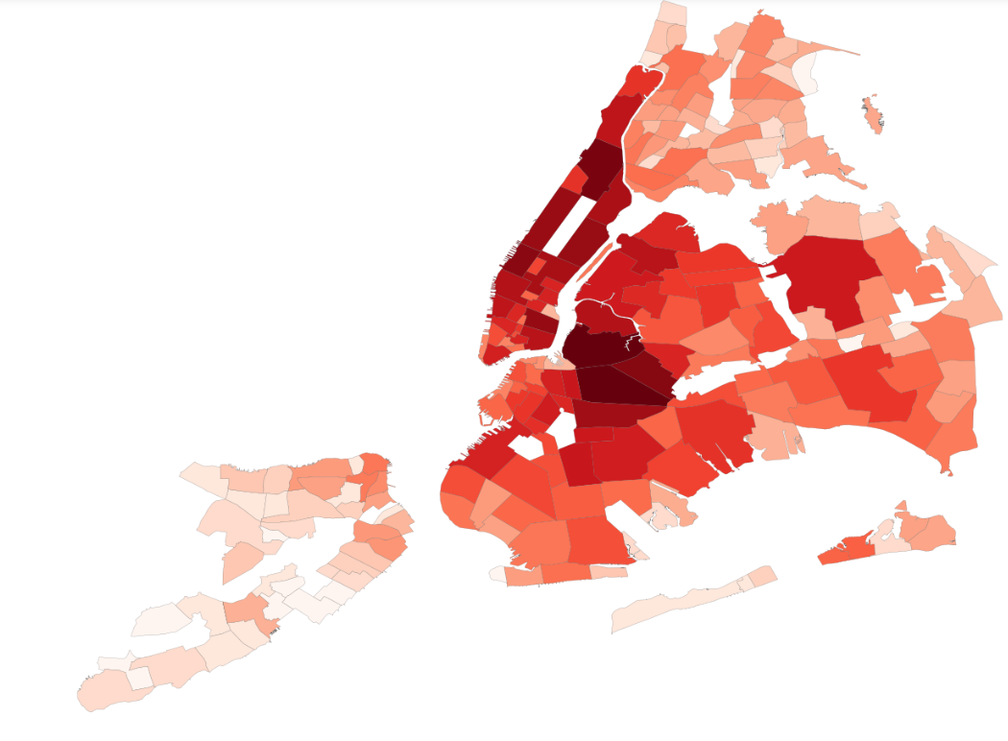
AirBnB Data: Listings Distribution
INSIGHT: Darker hues on Manhattan and Brooklyn indicate that these have the most AirBnB listings.

Slide 10
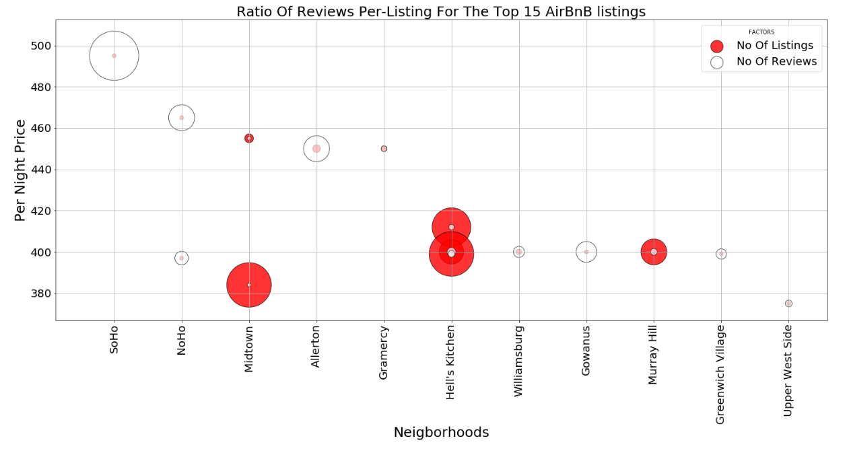
AirBnB : Top 15 Priciest Listings Analysis

Slide 11
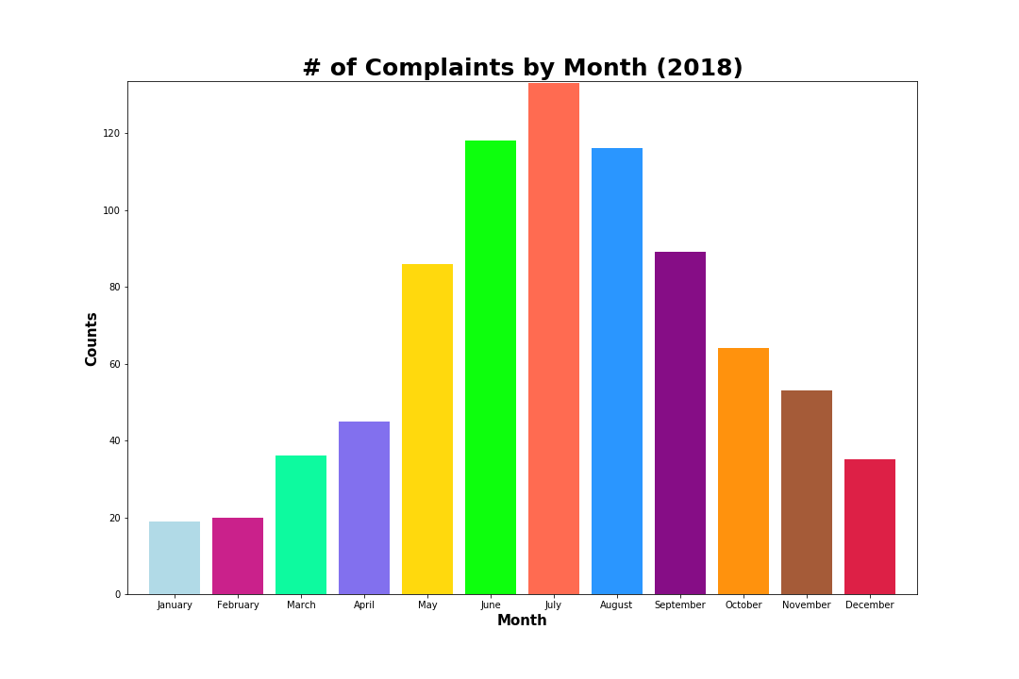
311 Data: Seasonality
INSIGHT: The highest number of complaints trended in the summer months (May-August), peaking in July.

Slide 12
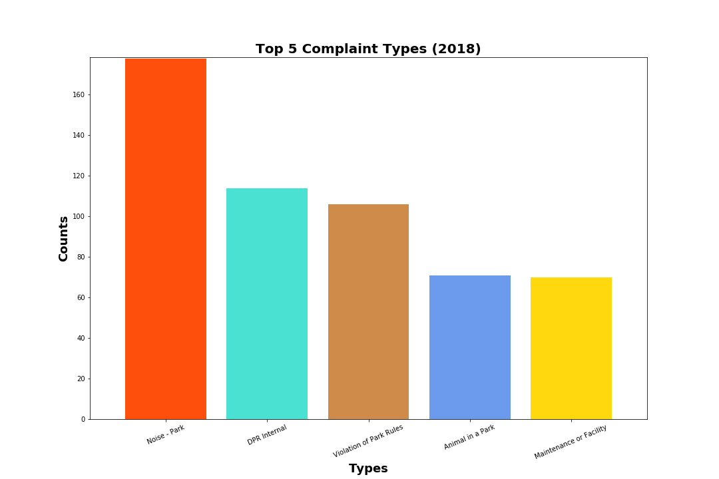
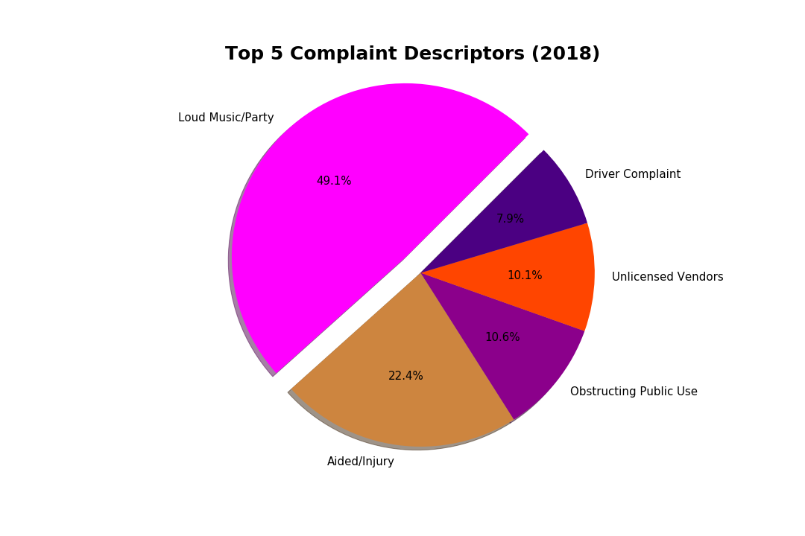
311 Data: Complaint Types and Descriptors
INSIGHT: The highest trending complaint type was Noise - Park, and the highest trending complaint type was Loud Music/Party.

Slide 13
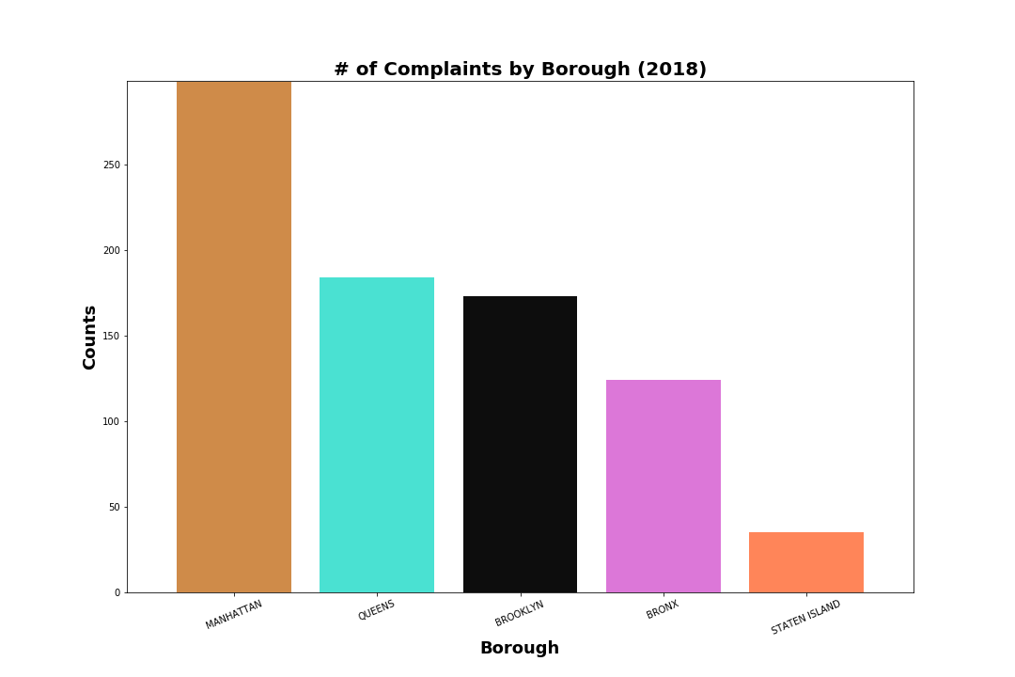
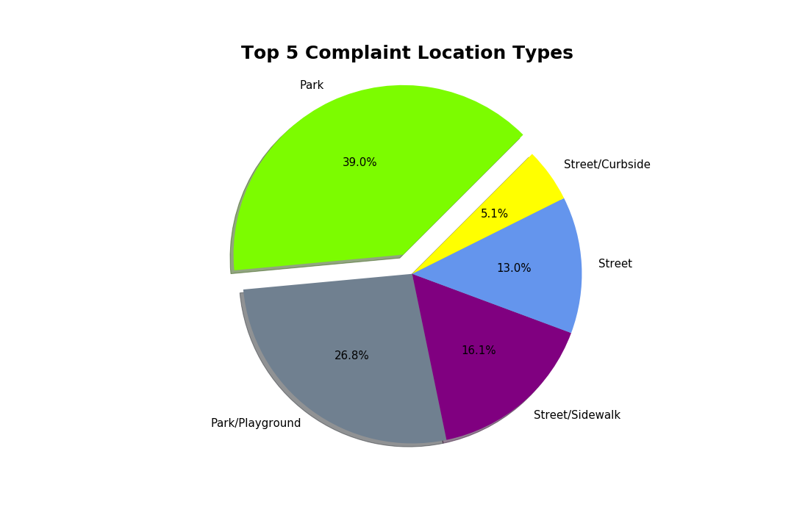
311 Data: Boroughs and Location Types
INSIGHT: The borough with the highest number of complaints was Manhattan, and the top trending complaint location types were all outdoors (parks, playgrounds, sidewalks, and streets).

Slide 14

StreetEasy, AirBnB and 311 Complaints Data Analysis

Slide 15
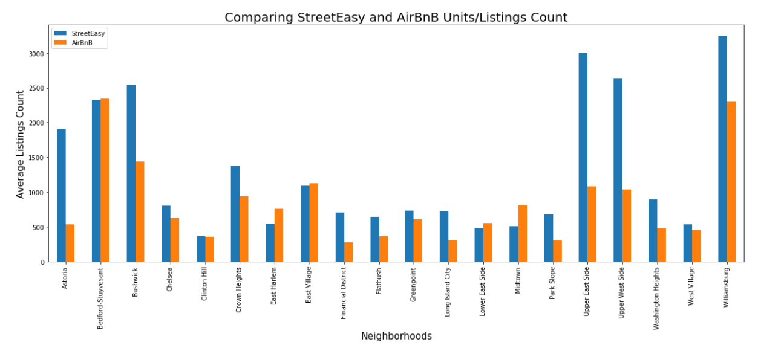
StreetEasy vs AirBnB Units Analysis

Slide 16
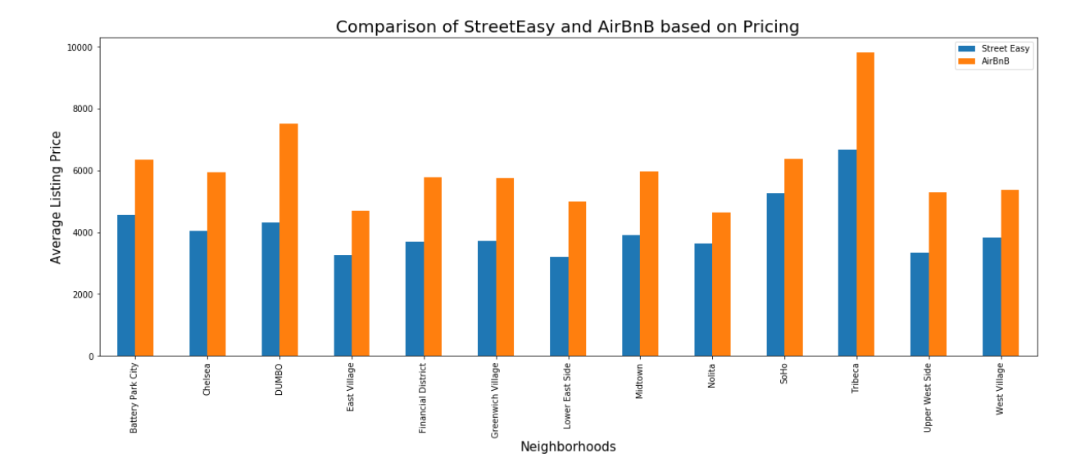
StreetEasy vs AirBnB Pricing Analysis

Slide 17
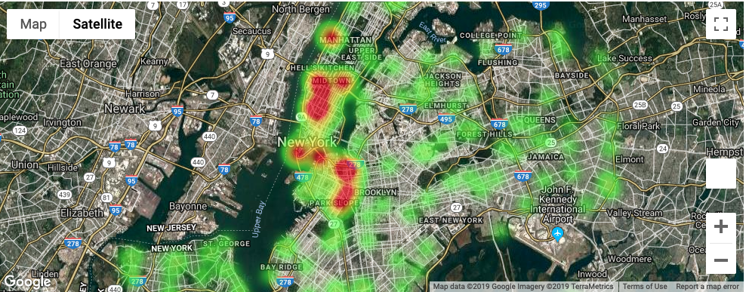
StreetEasy and AirBnB Data: Pricing Distribution 2018
INSIGHT: StreetEasy: Expensive long term rental prices trend Midtown to Downtown areas.
AirBnB: Expensive listings are scattered across Manhattan and Brooklyn.

Slide 18
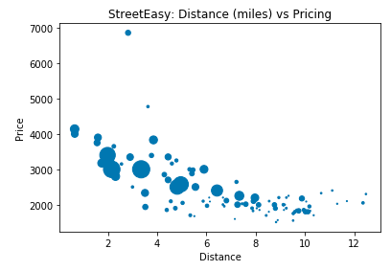
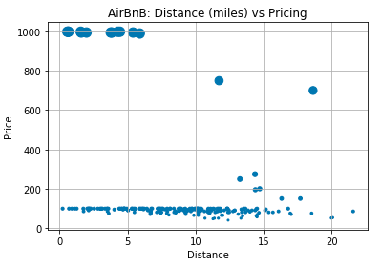
StreetEasy and AirBnB Data: Distance vs Median Asking Price 2018
INSIGHT: While Long rental pricing decreases as the listing moves away from the city center, short term rental doesn’t show a clear pattern. Instead the pricing does not change by too much as the listing is moving away.

Slide 19
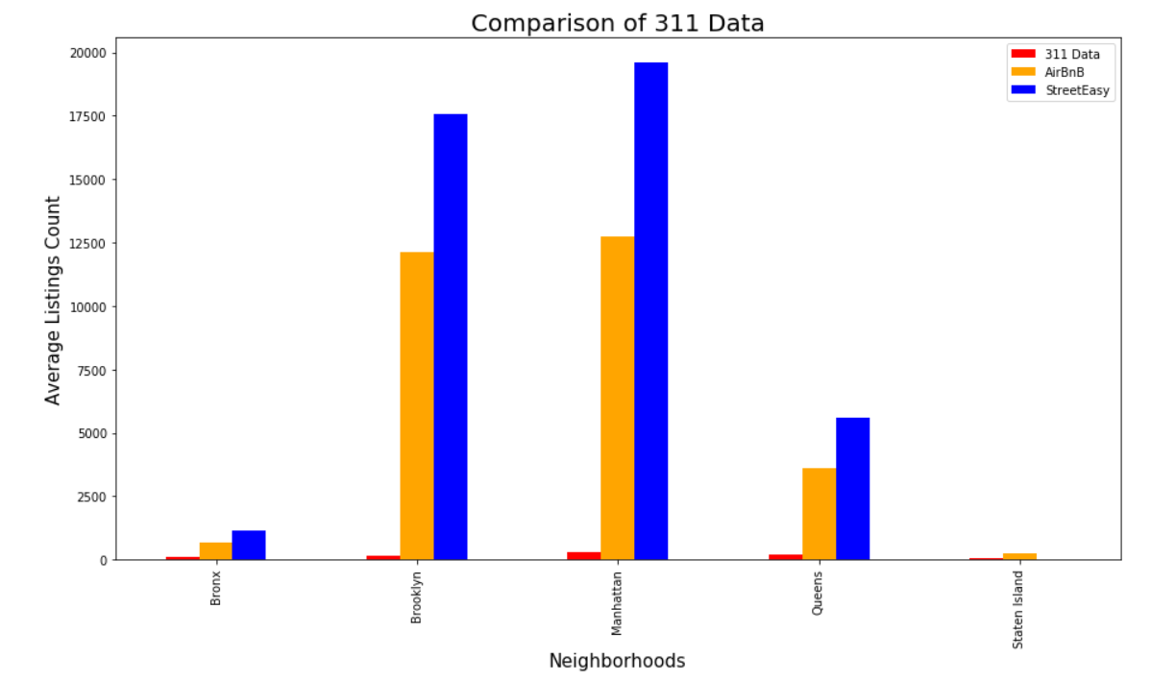
StreetEasy-AirBnB-311 Data Analysis

Slide 20
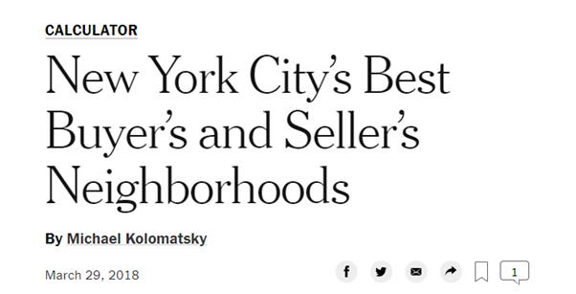
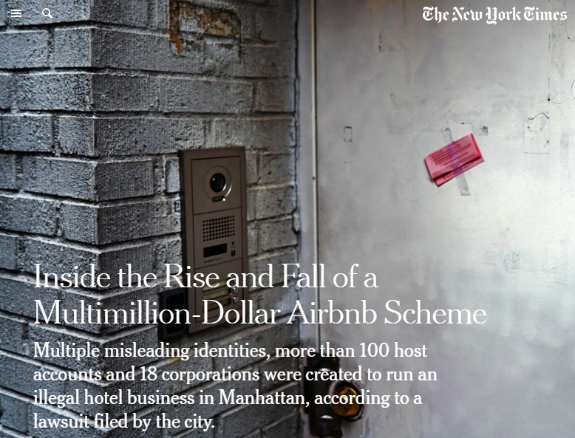

New York Times API Results
INSIGHT: Pricing Trends
INSIGHT: Soho trending high in pricing for AirBnB
INSIGHT: Prices are higher closer to city center and Manhattan is the Priciest

Slide 21

Conclusions and Limitations

Slide 22
Hypothesis Analysis
The neighborhoods with the cheapest rent will have more rental listings.
The neighborhoods with the maximum complaints impact pricing in short and long term rentals.
The average median price decreases as the distance from the city center increases.
Neighborhoods offering the most amount of listings are more expensive.
FALSE
FALSE
TRUE FOR LONG TERM, FALSE FOR SHORT TERM
TRUE FOR SHORT TERM, FALSE FOR LONG TERM

Slide 23
Conclusions
Airbnb 30-day rentals are more expensive than rentals listed on StreetEasy.
The number of AirBnB listings popping up in various neighborhoods varies across boroughs and the trend observed is more residential the neighborhood lesser the listings and commercial neighborhood rental listings have a stiff competition from AirBnB.
The cost of accommodation decreases as one moves away from the city center as far as long term rentals are considered, but short term listings do not exhibit a deviation in pricing for the same criteria.
There is a lack of relationship between neighborhoods registering the maximum number of complaints and the ones with lowest prices of long term and short term rental.

Slide 24

Limitations and Challenges
Dealing with large Size datasets.
Lack of content information
Merging datasets was a challenge due to lack of common columns
Lack of time to explore and understand the data better
One team member short
Modified approach in analysing hypothesis

Slide 25

Questions

